Slide 1

“Deep Learning Approach for Roadside Surveillance”
A Presentation on Academic Internship presented in partial fulfillment of the requirements for the degree of Bachelor of Technology by
Soumodeep Biswash (212010014026)
Raihan Ahmed Sadiyal (212010014021)
Deep Acharjee (202010026007)
Kamalika Roy (212010014010)
Sagnik Dey (212010014023)
BARAK VALLEY ENGINEERING COLLEGE
(Affiliated to ASTU, Approved by AICTE)
Nirala, Karimganj, Assam-788701
August 2022

Slide 2






6
1
4
5
2
3
Introduction
(Slide no. 3)
Conclusion
(Slide no. 14)
Materials & Methodology
(Slide no. 9)
Results & Discussion
(Slide no. 13)
Literature Review
(Slide no. 7)
Aim & Objective of the Research
(Slide no. 8)
CONTENTS
Introduction to the Field of Research
Problem Statement
Conclusion & Future Scope
References
Materials used for the work
Methodology of the work
Key Findings of the work
Result Discussions
Previous Works & their key Findings
Aim of the Work
Objective of the work

Slide 3
INTRODUCTION TO FIELD OF WORK

Slide 4
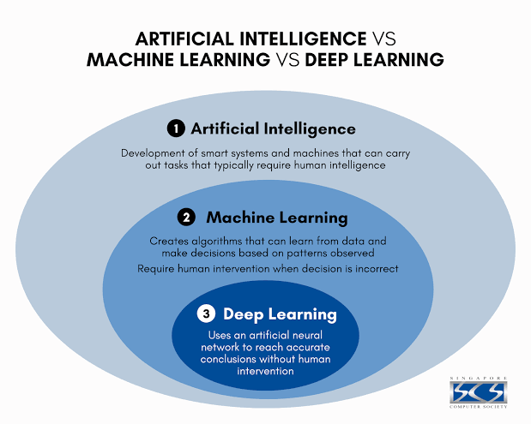
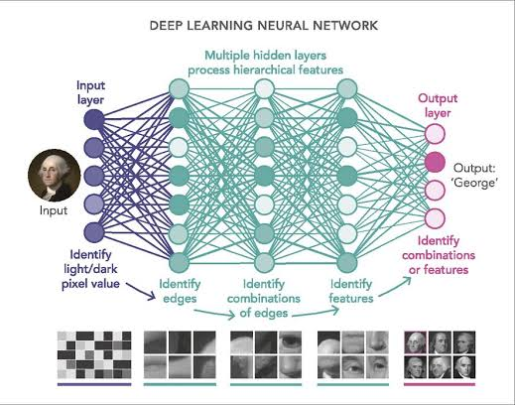
Deep Learning
Why Deep Learning matters?
Deep learning achieves recognition accuracy at higher levels than traditional Machine Learning before due to their neural network architecture.
What is Deep Learning?
Deep learning is a machine learning technique that teaches computers to do what comes naturally to humans: learn by example.
How Deep Learning Works?
Most deep learning methods use neural network architectures, which is why deep learning models are often referred to as Deep Neural Networks.
Applications
Used in automated driving applications to detect objects such as stop signs & traffic lights.
Used in medical research for applications like automatic detection of cancer cells.
Figure 1: Difference Between Artificial Intelligence, Machine Learning & Deep Learning
Figure 2: Deep Learning Neural Network

Slide 5
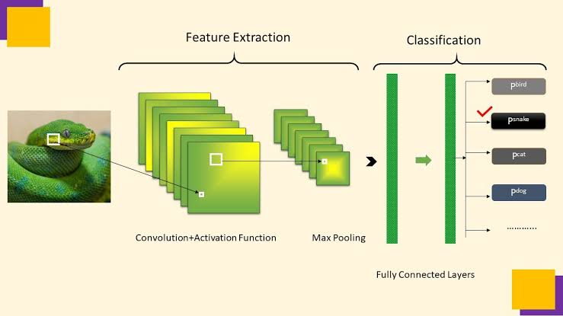
Convolutional Neural Networks
CNN LAYERS
Fully Connected Layer
In this layer, image classification happens based on the features extracted in the previous layers. Here, all the nodes from one layer are connected to every node of the next layer.
Pooling Layer
Works similar to the convolution layer but it mainly focuses on reducing the number of parameters (features) from the input to reduce complexity & increase efficiency of the CNN.
Convolutional Layer
The process of convolution takes place in this layer to check for the presence of a feature. More of such layers can follow the initial one.
CNN Architecture
A CNN architecture mainly consists of the following three layers:
Convolutional Layer as the first layer.
Pooling Layer as the middle layer.
Fully Connected Layer as the last layer.
What are Convolutional Neural Networks?
A CNN is a type of network architecture for deep learning algorithms & is specifically used for image recognition & tasks that involve the processing of pixel data.
Figure 3: Convolutional Neural Network Architecture

Slide 6
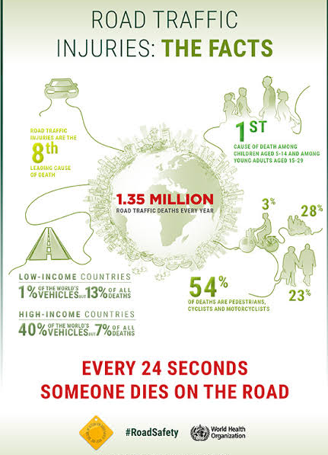
PROBLEM STATEMENT
According to WHO, as of 2022, road accidents cause 1.3 million deaths annually
According to CTIF, there were 4 million fire incidents in 2020 which result in 20,700 deaths.
Delayed contact with emergency services worsens situations, endangering lives and causing property damage.
Increase in urban traffic raises the risk of accidents, especially in high-density areas.
Emergency services, like ambulances, face delays in reaching destinations due to traffic congestion.
Critical situations, such as cardiac arrests, are affected by slower access to medical care.
Figure 4: World Accident Statistics released by WHO

Slide 7
LITERATURE REVIEW
1
TITLE:
“Fire Detection Method in Smart City Environments Using a Deep-Learning-Bas
ed Approach”
AUTHORS:
Kuldoshbay Avazov, Mukhriddin Mukhiddinov, Fazliddin Makhmudov and Young Im Cho
KEY FINDINGS:
A novel convolutional neural network was developed to detect fire regions using an enhanced You Only Look Once (YOLO) v4network with an accuracy of 96%.
2
TITLE:
“Automatic Detection of Traffic Accidents from Video Using
Deep Learning Techniques”
AUTHORS:
Sergio Robles-Serrano, German Sanchez-Torres and John Branch-Bedoya
KEY FINDINGS:
An automated DL-based method capable of detecting traffic accidents
on video was developed that achieved an accuracy of 98% on public traffic accident dataset.
3
TITLE:
“Deep Learning applied to Road Accident Detection with Transfer
Learning and Synthetic Images”
AUTHORS:
Tiago Tamaguskoa
, Matheus Gomes Correiaa
, Minh Anh Huynhb
, Adelino Ferreiraa
KEY FINDINGS:
Synthetic images of accidents were created & EfficientNetB1 & MobileNetV2 were used as base models for transfer learning which achieved an accuracy of 88% & 82% respectively.
4
TITLE:
“Camera-based Smart Traffic State Detection in
India using Deep Learning Models”
AUTHORS:
Nimish Agarwal, Aman Jangid, Ashutosh Sharma, Nikhil Kumar, Mudit Kumar, Pankaj Kumar
Pranamesh Chakraborty
KEY FINDINGS:
The developed models were found to perform decently
in Indian traffic conditions with more than 90% accuracy.
5
TITLE:
“An Automated Precise Authentication of Vehicles for
Enhancing the Visual Security Protocols”
AUTHORS:
Kumarmangal Roy, Muneer Ahmad, Norjihan Abdul Ghani, Jia Uddin and Jungpil Shin
KEY FINDINGS:
The performance assessment of the proposed solution yields a precision of 98% on real-time data for Malaysian number plates.

Slide 8
AIM & OBJECTIVES
OBJECTIVES
Development of multiple CNN based Transfer Learning Models
Using Ensemble Learning to boost the performance of the overall proposed Model so as to achieve better output as compared to previous works
Development of a Separate ANPR model so as to aim for a Crash Triggered ANPR System by combining the ANPR model with the proposed Multiclass Classification Model
AIM
Multiclass Classification of Roadside Surveillance data
Automatic Number Plate Recognition

Slide 9
MATERIALS & METHODOLOGY

Slide 10
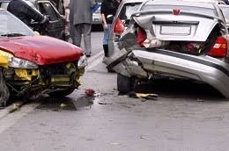
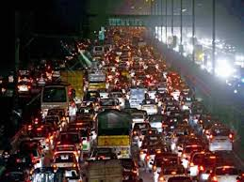
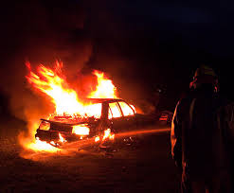
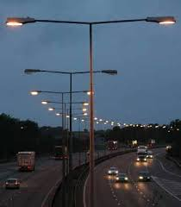
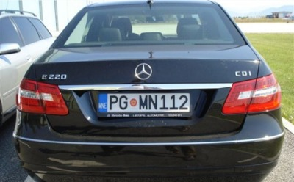
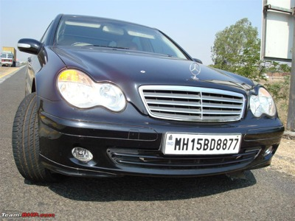
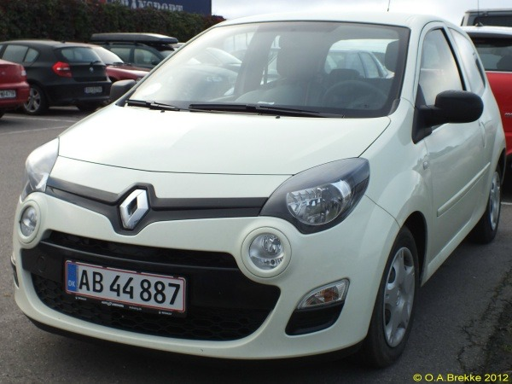
Materials
For Automatic Number Plate Recognition Model
For Multiclass Classification of Roadside Surveillance Data Model
‘TrafficNet’ Dataset from Kaggle
Consists of a total of 3600 training images & a total of 800 validation images
Labels used in the database- ‘accident’, ‘dense_traffic’, ‘fire’, ‘sparse_traffic’
Each label had equal number of images for training & testing
‘Car License Plate Detection’ Dataset from Kaggle
Consists of a total of 433 images of car license plates
Each had their bounding box annotations of the car license plates within the image
accident
dense_traffic
fire
sparse_traffic
Figure 5: Sample Images from TrafficNet Dataset
Figure 6: Sample Images from Car License Plate Detection Dataset

Slide 11
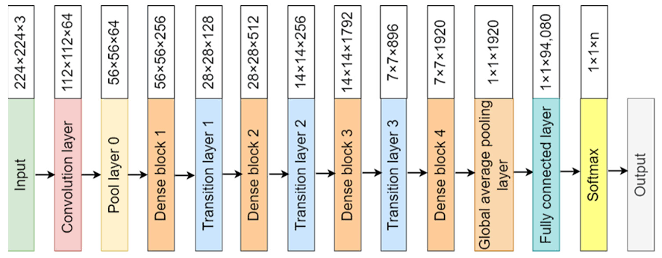
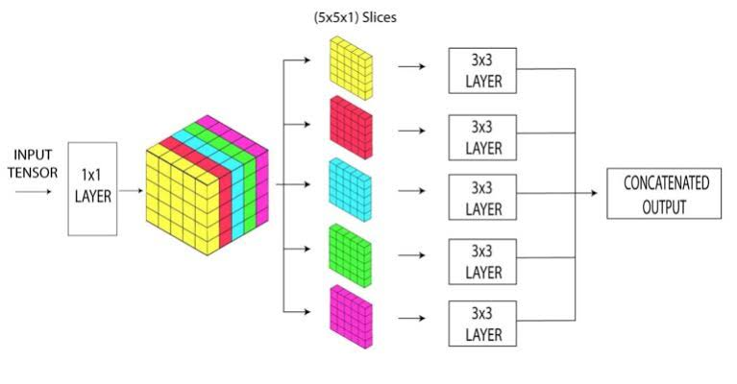
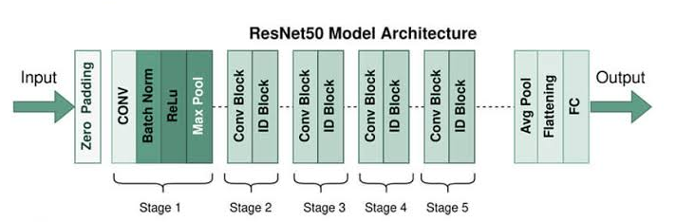
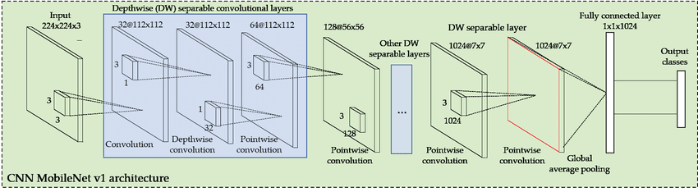
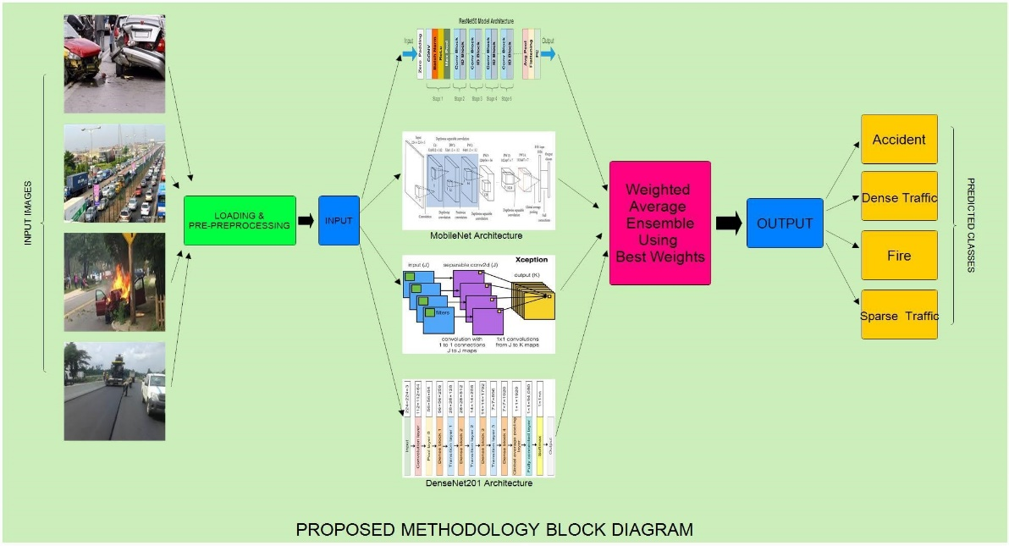
Methodology
Pre-Processing & Augmentation
Hyperparameter Selection
Individual Transfer Learning Approaches
Ensemble Learning Approach
For Multiclass Classification of Roadside Surveillance Data Model
Loading 32 Images at a time using parallel method.
Image Augmentation with a horizontal flip of -45 degrees to +45 degrees, & pixel normalization.
Loss-Function Categorical Focal Loss
Optimizer
Adam
Learning Rate
0.0001
No. of epochs ran
25
Using pre-trained CNN models without their top classification layer for feature extraction.
Using a Dense Layer along with a softmax layer for pattern recognition & classification of multiple classes.
Figure 10: MobileNet Architecture
Using Grid search on the predictions made by individual models to find the best possible combination of weights.
Normalizing these weights to be applied in weighted average approach to achieve best possible performance.
Figure 7: ResNet50 Architecture
Figure 8: Xception Architecture
Figure 9: DenseNet201 Architecture
Figure 11:- Final Proposed Multiclass Classification Model

Slide 12
Methodology
For Automatic Number Plate Recognition Model
Object Detection Pipeline Configuration with following
Hyper-Parameters:
Optimizer – Adam
Learning Rate – 0.07
No. of Steps - 8000
Loading Pre-trained mobilenet-SSD object-detection model
Training of pre-trained model using given dataset
Setting of detection threshold at 70% confidence score
EasyOCR implementation for text recognition & extraction
Loading Pre-trained model
Text Extraction
Post-processing and Visualisation
Pipeline configuration
Training
Inference and Visual enhancement
Figure 12: Proposed Model for ANPR

Slide 13
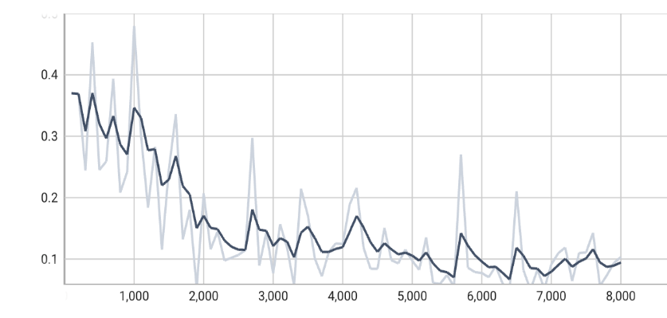
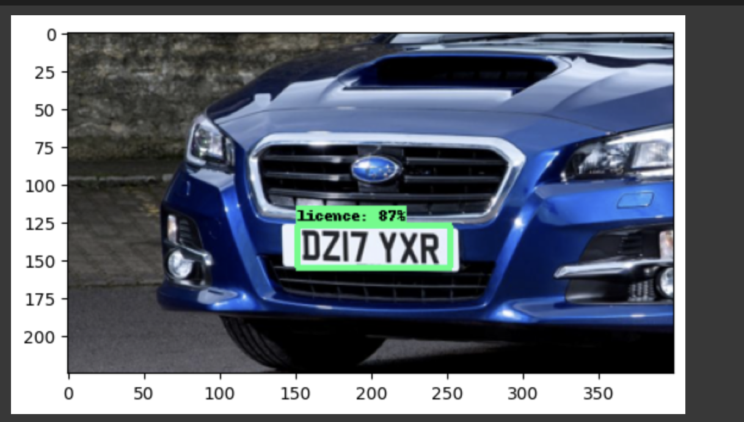
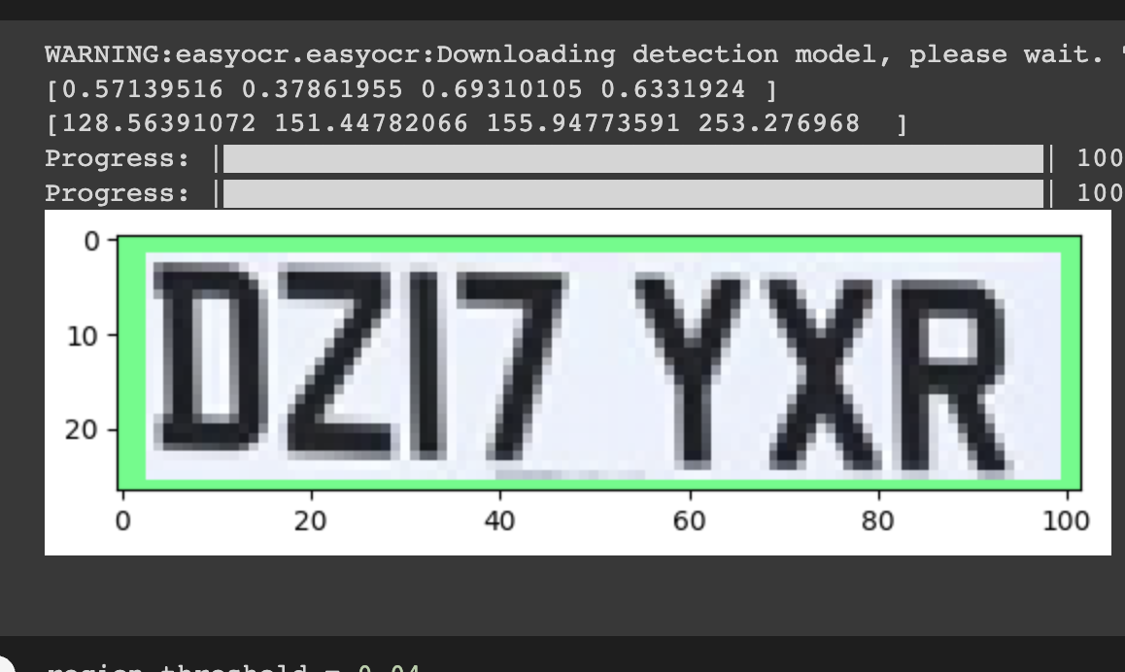
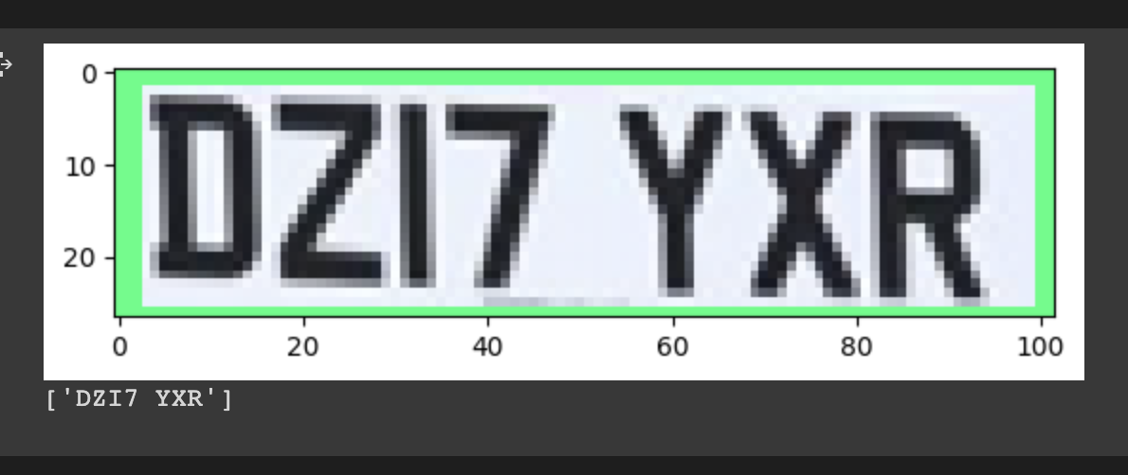
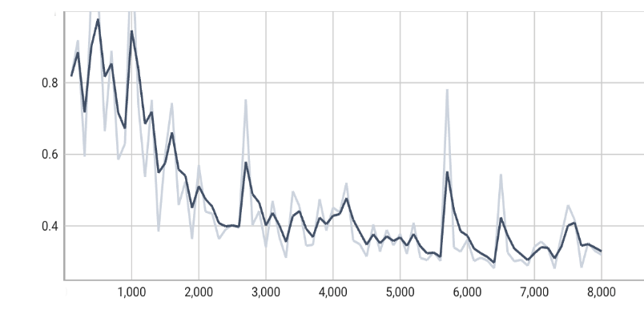
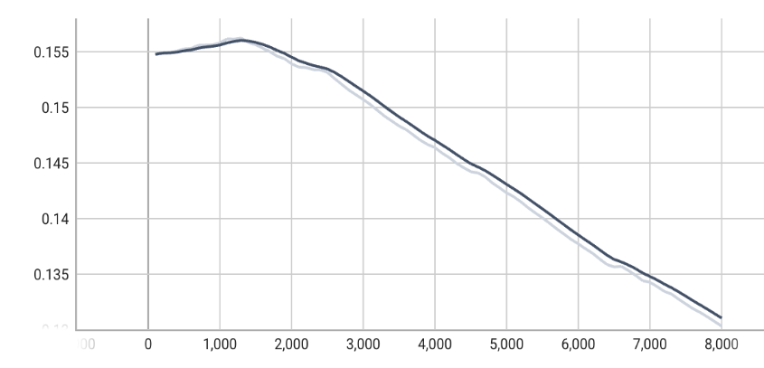
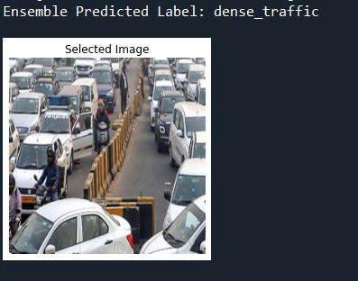
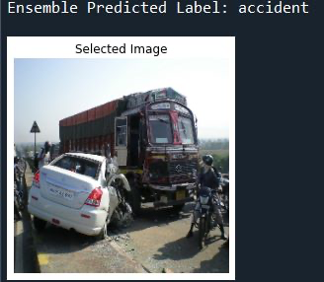
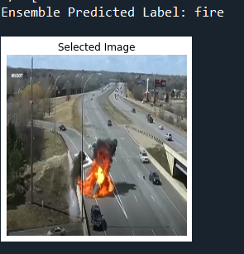
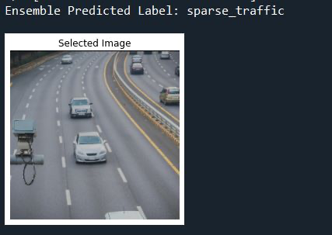
RESULTS & DISCUSSION
For Multiclass Classification of Roadside Surveillance Data Model
For Automatic Number Plate RecognitionModel
Figure 13: Localisation Loss
Figure 16: Detected License Plate with Confidence Score
Figure 17: Region of Interest & coordinates
Figure 18: Extracted Text with OCR
Figure 14: Total Loss
Figure 15: Regularisation Loss
CNN Architecture Used | Accuracy (in %) | Precision | Recall | F1-Score
DenseNet201 | 94.25 | 0.9339 | 0.9312 | 0.9312
Xception | 93.50 | 0.9273 | 0.9263 | 0.9265
ResNet50 | 93.50 | 0.9269 | 0.9250 | 0.9253
MobileNet | 92.25 | 0.9318 | 0.9312 | 0.9312
Table 1: Performance Results for Individual Transfer Learning Approaches
Ensemble technique | Accuracy(in %) | Precision | Recall | F1 score
Grid search for best weights | 95.75 | 0.96 | 0.96 | 0.96
Stacking with Logistic Regression | 95.625 | 0.96 | 0.96 | 0.96
Weighted Average | 95.38 | 0.95 | 0.95 | 0.95
Average | 95.25 | 0.95 | 0.95 | 0.95
Cross- Validation | 95.12 | 0.95 | 0.95 | 0.95
Softmax on combined outputs | 94.75 | 0.95 | 0.95 | 0.95
Majority Voting | 94.75 | 0.95 | 0.95 | 0.95
Figure 19: Predicted Samples of Proposed Multiclass Classification of Roadside Surveillance Data Model
Table 2: Performance Results of various Ensemble Learning Approaches

Slide 14
CONCLUSION
Proposed ANPR model demonstrates satisfactory results in detection & recognition of Number Plates from images
Proposed Model Demonstrates high performance in Multi-Class Classification of Roadside Surveillance Data
Future Scope
Performance of the given ANPR model can be made more suitable for implementation on surveillance cameras
Performance of Proposed Multiclass Classification model can be more optimised by using Video data

Slide 15
THANK YOU

Slide 16
REFERENCES
Avazov, Kuldoshbay, et al. "Fire detection method in smart city environments using a deep-learning-based approach." Electronics 11.1 (2021): 73.
Robles-Serrano, Sergio, German Sanchez-Torres, and John Branch-Bedoya. "Automatic detection of traffic accidents from video using deep learning techniques." Computers 10.11 (2021): 148.
Tamagusko, Tiago, et al. "Deep learning applied to road accident detection with transfer learning and synthetic images." Transportation research procedia 64 (2022): 90-97.
Agarwal, Nimish, et al. "Camera-based smart traffic state detection in india using deep learning models." 2021 International Conference on COMmunication Systems & NETworkS (COMSNETS). IEEE, 2021
Roy, Kumarmangal, et al. "An Automated Precise Authentication of Vehicles for Enhancing the Visual Security Protocols." Information 14.8 (2023): 466.

